Slide 1

Optimal Control of Distributed Computing
Networks With Mixed-Cast Traffic Flows
戚一嘉豪 李鹏 张嘉楠老师

Slide 2
Content
Part4
Part1
Part3
Part2
Discussion
Background
Methodology
Part5
Part6
Preface
Results
Summary

Slide 3
Background
PART 1

Slide 4

Background
Preface
Methodology
Discussion
Results
Summary
Emergence
of Augmented Information Services
1. real-time processing of source data
2. complex service function chains
Scalability and Adaptability Concerns
Convergence of Networking and Computing
1
1. closer to information sources and end-users
2. joint optimization of communication and computation resources.
adapt to changing traffic patterns, service demands, and network configurations without requiring significant manual intervention or reconfiguration
5
2
Increased Complexity in Traffic Patterns
Demand for Low Latency and High Throughput
4
3
a diverse mix of traffic, including unicast, multicast, and even broadcast or anycast flows
data packets must undergo specific processing steps
considering the need to balance traffic across both communicational and computational resources.

Slide 5
Preface
PART 2

Slide 6
Background
Preface
Methodology
Discussion
Results
Summary
Universal Computing Network Control (UCNC) is the first throughput-optimal policy for non-unicast traffic in distributed computing networks with both communication and computation constraints
i
are processed by a specified chain of service functions
UCNC
ii
follow cycle-free routes between consecutive functions
iii
are delivered to their corresponding set of destinations via proper packet duplications

Slide 7
Methodology
PART 3

Slide 8
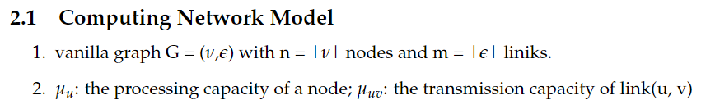

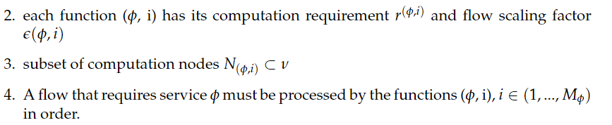
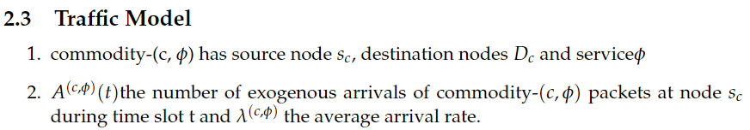
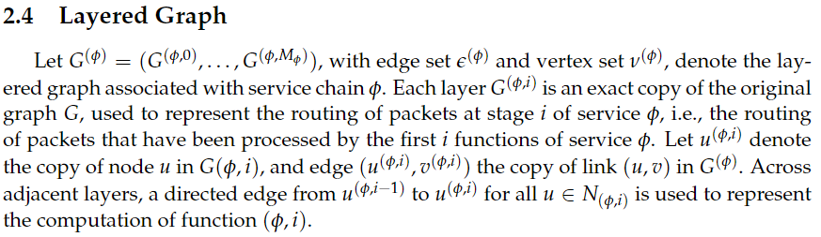
Background
Preface
Methodology
Discussion
Results
Summary
Notation

Slide 9
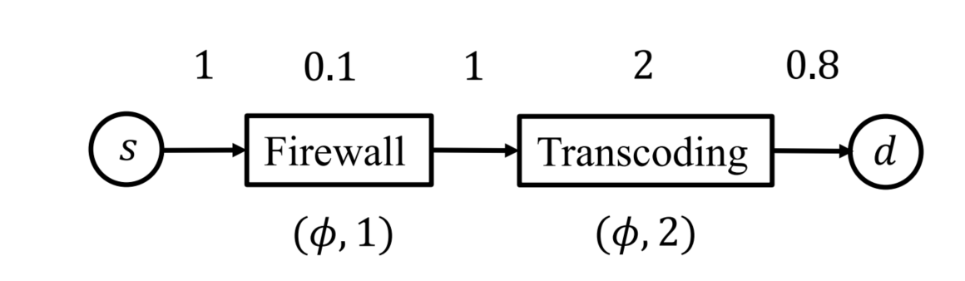
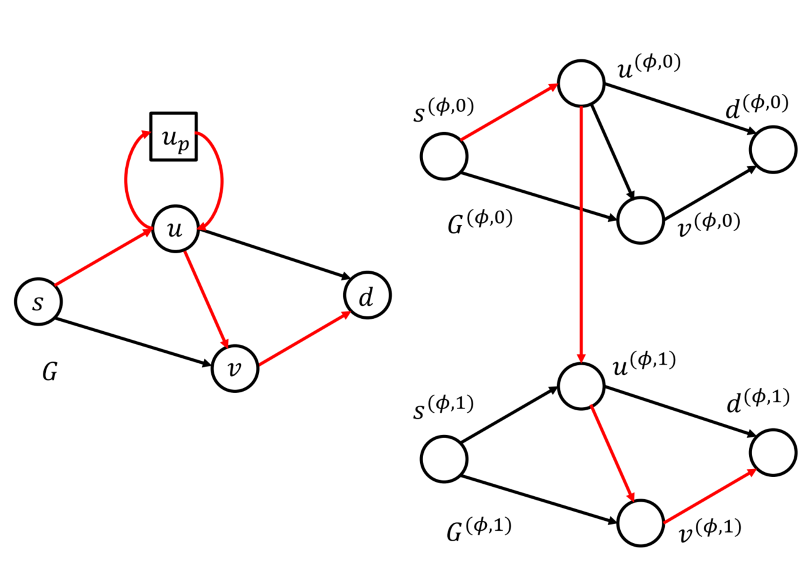
Background
Preface
Methodology
Discussion
Results
Summary
Service Model
example
Layered
Graph

Slide 10
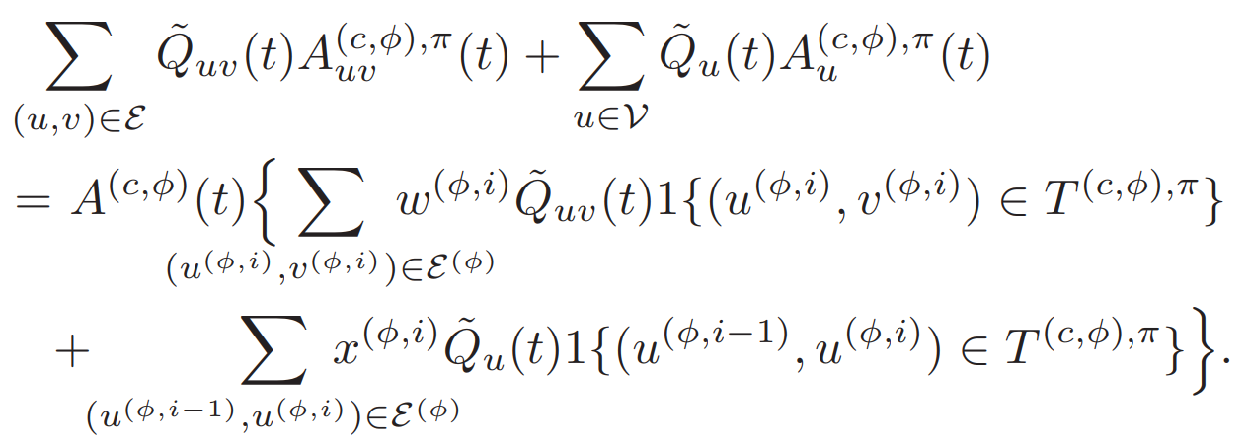
Background
Preface
Methodology
Discussion
Results
Summary
Initialization: Start with a distributed computing network modeled as a graph. Initialize virtual queues
Preprocessing for Incoming Packets: For each incoming packet, identify its service chain. Construct a layered graph for the packet’s service chain.
Route Selection in the Virtual System: Calculate the cost of routing and processing. Find the optimal route.
UCNC
Packet Scheduling in the Physical Network: Apply the route decisions made in the virtual system to the physical network. Use the Extended Nearest-to-Origin (ENTO)
Virtual Queues Update: Update virtual queues. Process departures from virtual queues
Actual Queues Update: Update actual queues. Process departures from virtual queues

Slide 11
Discussion
PART 5

Slide 12
Background
Preface
Methodology
Discussion
Results
Summary
Shortest Path Problems' Algorithms?
Mathematical proof
Where to copy commodity for multicast problem?
Service chain path
Steiner tree
Different commodities come at the same time?
Capacity Region

Slide 13
Results
PART 5

Slide 14
Background
Preface
Methodology
Discussion
Results
Summary
0
0 2
1 1
2 3
4 3
5 2
6 3
7 4
9 4
1
0 2
1 2
2 1
3 2
4 4
5 2
6 1
7 3
8 4
9 3
…
For the first line, I generate num_commodity, that means how many different kind of commodities that may come into this network. Next we will get num_commodity sets of inputs, the first line of each set of inputs represents the commodity’s id. The first number in the second line represents its source node, and the following numbers represent its destination node (there may be more than one). The last line is its service chain, in groups of two digits. The first number in each group is r(output rate), and the second number is ϵ(scaling factor).
For the remaining part, we track packets arriving from time 0 up to max_time. At each time point t, we identify the commodity by its id and count the number of packets for it that arrive at that particular time.
10
0
1 7
1.87 1.4 0.83 1.77 0.95 1.4 1.26 1.94
1
7 1 4 10 11
0.12 1.97 1.64 1.76 1.09 1.78 0.46 1.9
…

Slide 15
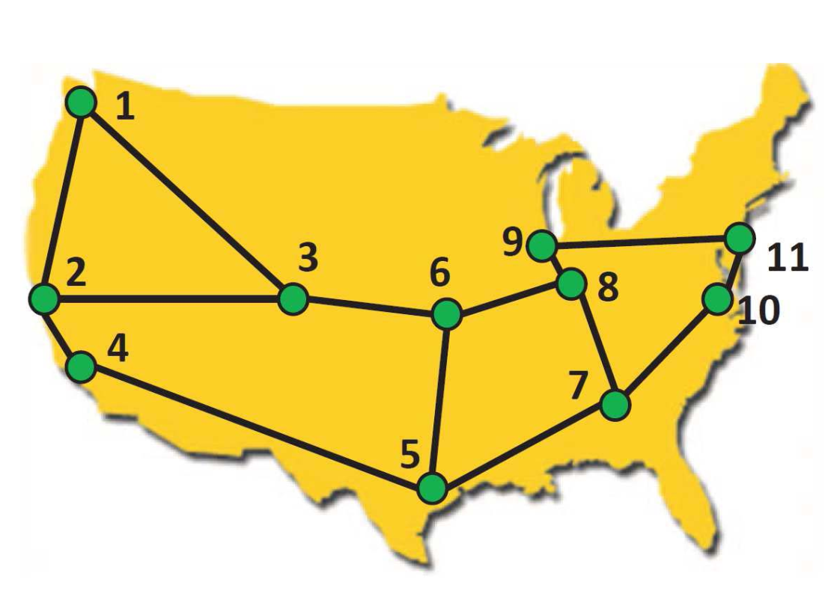
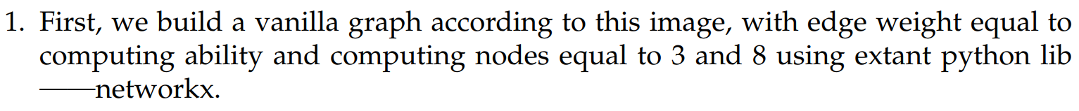
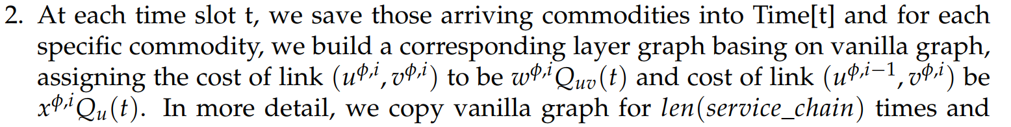
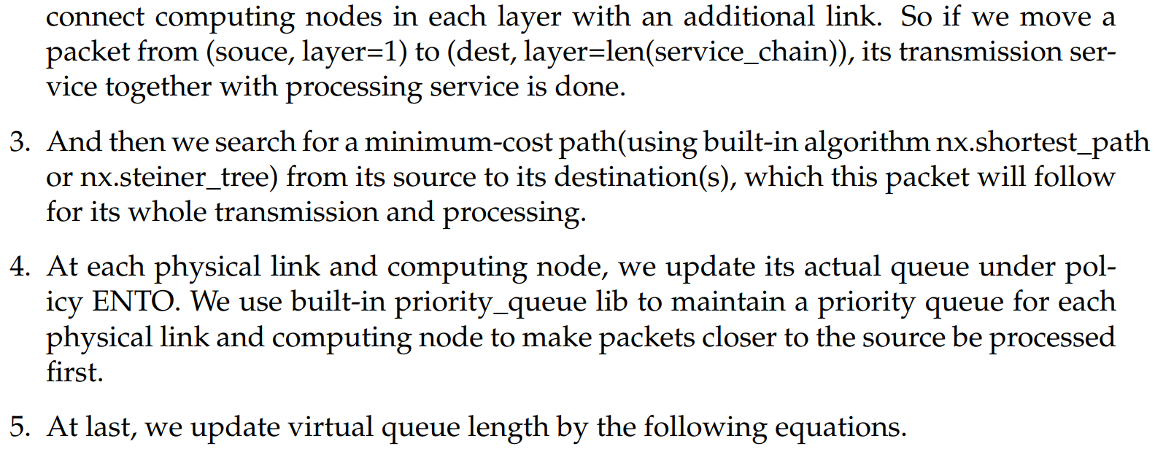
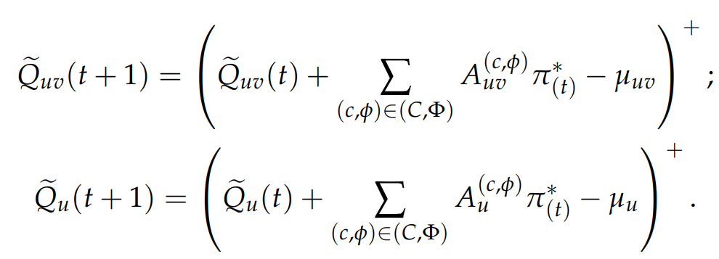
Background
Preface
Methodology
Discussion
Results
Summary

Slide 16
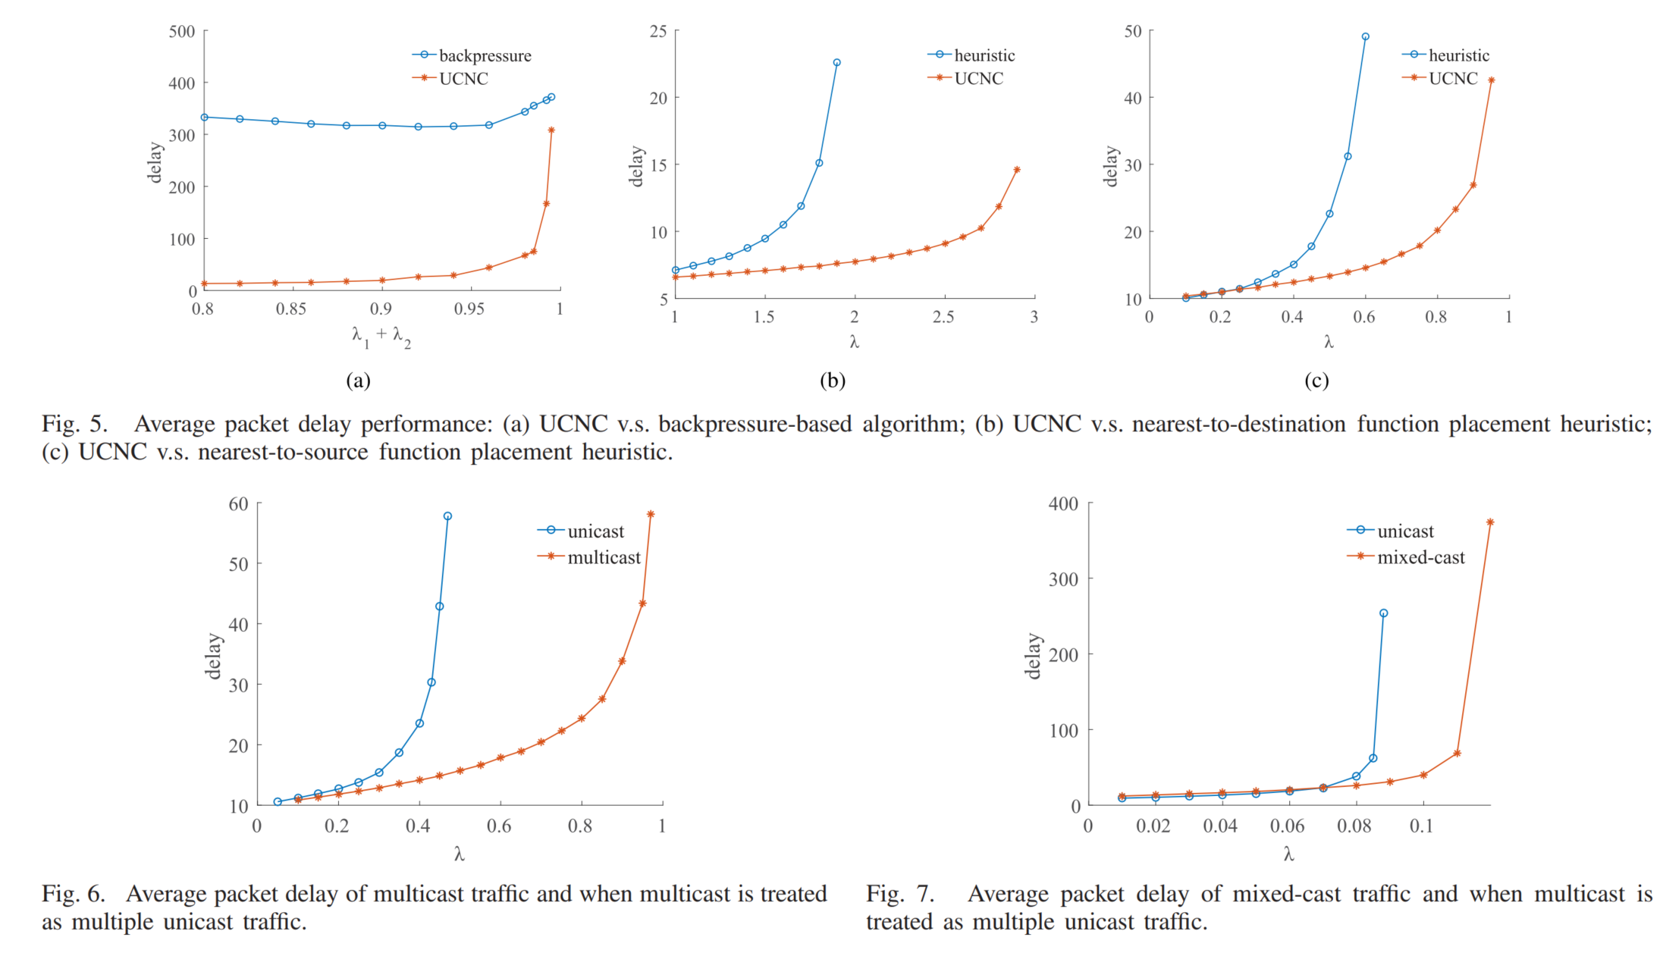
Background
Preface
Methodology
Discussion
Results
Summary

Slide 17
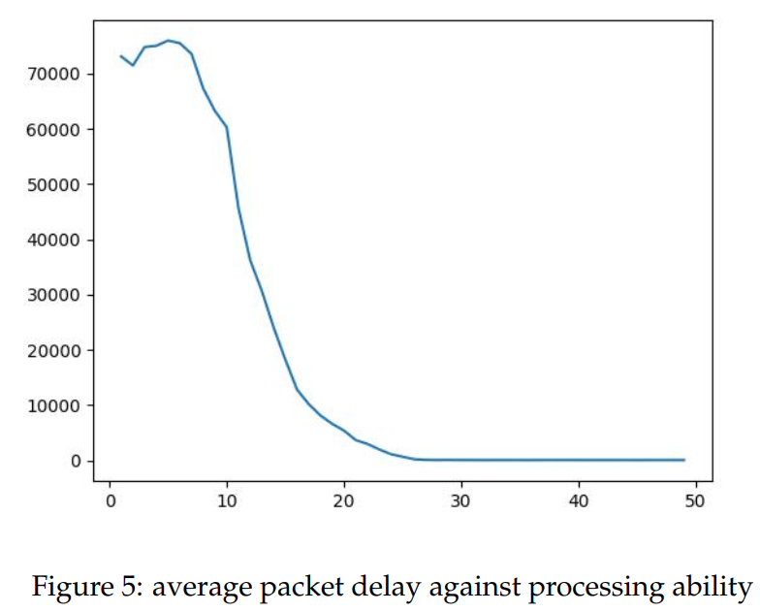
Background
Preface
Methodology
Discussion
Results
Summary

Slide 18
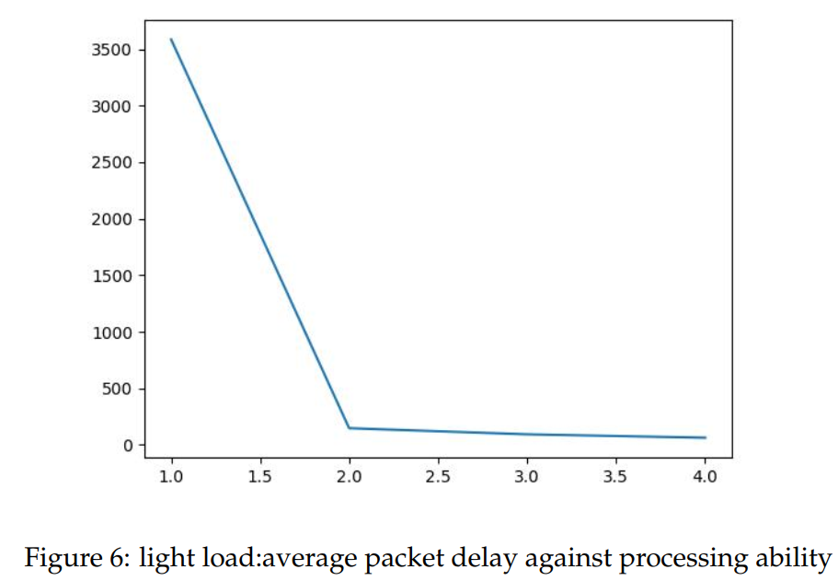
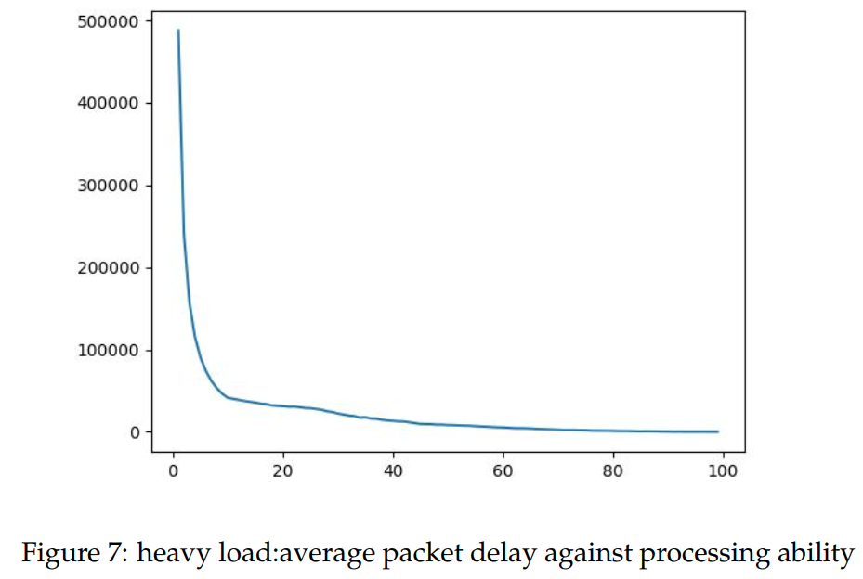
Background
Preface
Methodology
Discussion
Results
Summary

Slide 19
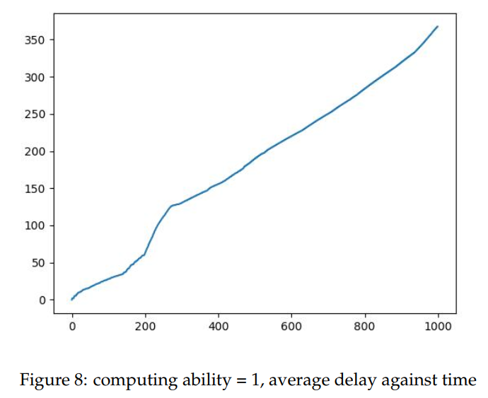
Background
Preface
Methodology
Discussion
Results
Summary

Slide 20
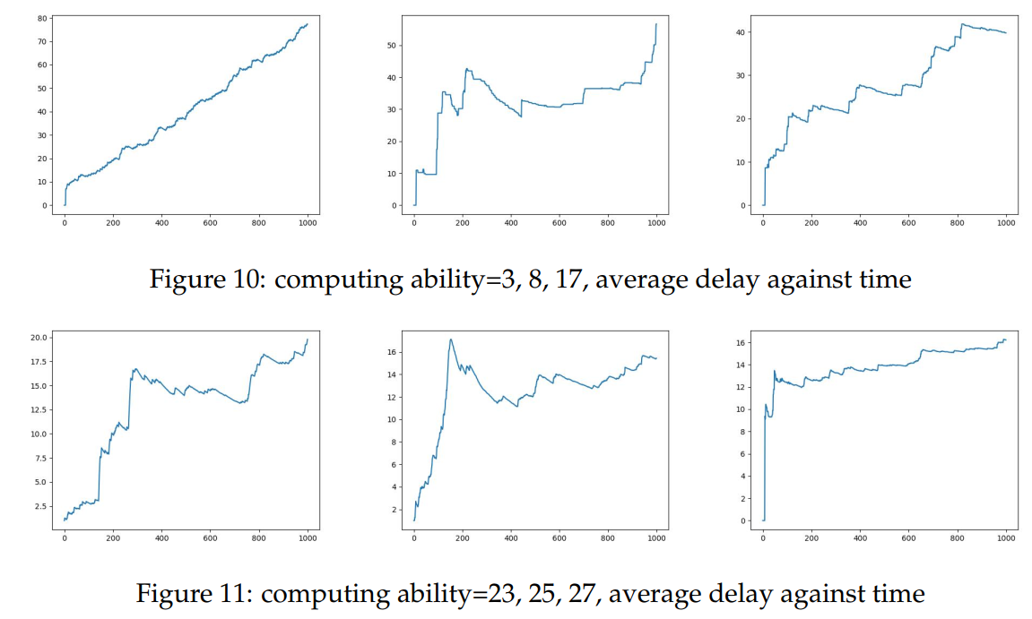
Background
Preface
Methodology
Discussion
Results
Summary

Slide 21
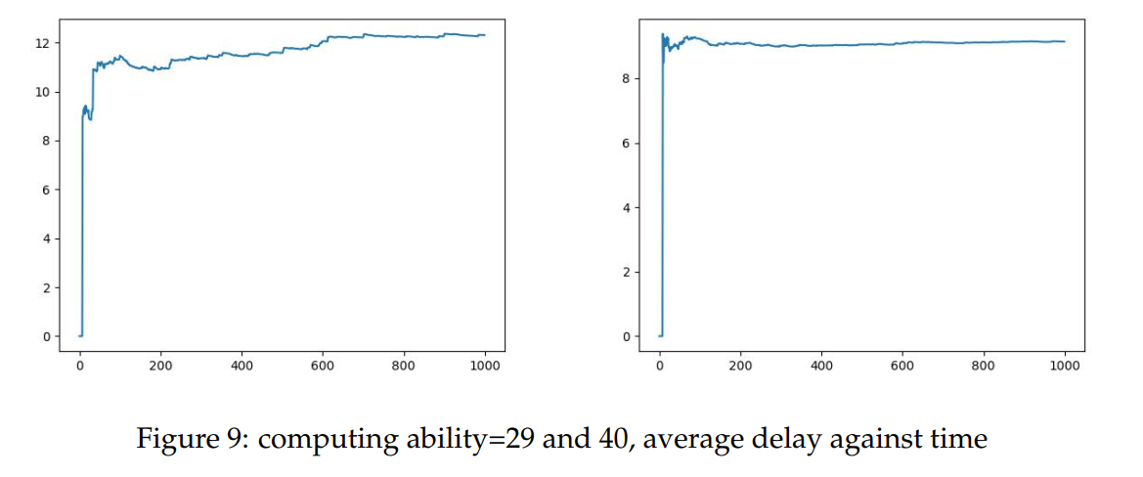
Background
Preface
Methodology
Discussion
Results
Summary

Slide 22
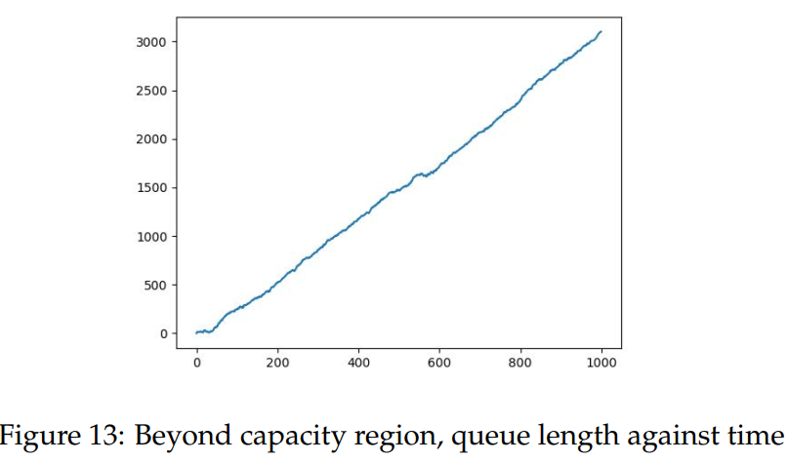
Background
Preface
Methodology
Discussion
Results
Summary

Slide 23
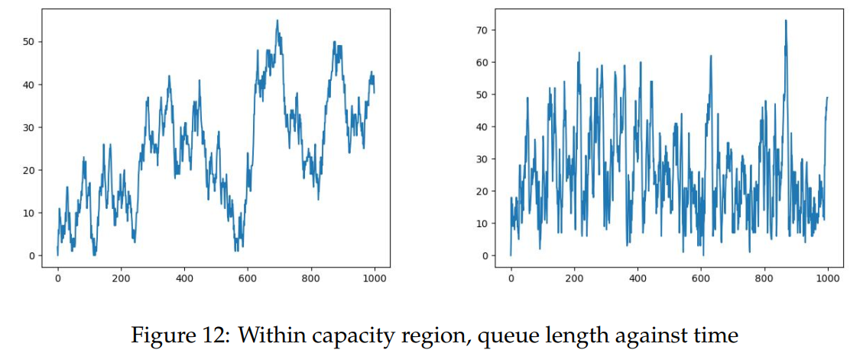
Background
Preface
Methodology
Discussion
Results
Summary

Slide 24
Summary:
PART 6
We characterized the capacity region and developed the first
throughput-optimal control policy (UCNC) for unicast and
multicast traffic in a distributed computing network. UCNC
handles both communication and computation constraints,
flow scaling through service function chains, and packet duplications. Simulation results suggest that UCNC has superior
performance compared with existing algorithms.

Slide 25
Thanks for listening
Reference: Zhang, J., Sinha, A., Llorca, J., Tulino, A. M., & Modiano, E. (2021). Optimal control of distributed computing networks with mixed-cast traffic flows. IEEE/ACM Transactions on Networking, 29(4), 1760-1773.
戚一嘉豪 李鹏 张嘉楠老师

